Slide 1
Video Game Analytics Pipeline
Yusen Xia

Slide 2
Project Goals and Dataset Description
Build an analytics pipeline to help people have a better idea of video game market trends
Dataset:
Kaggle Steam game analytics CSV file
About 220,000 rows and 28 columns
Includes game name, genre, publisher, price, release date, etc.
Including missing values and messy text, so cleaning is necessary

Slide 3






Pipeline Steps
Stored the clean data into Google Cloud Storage
Using kaggle to get the raw data file
Used Python to clean the dataset
Loaded the cleaned dataset into BigQuery
Connected BigQuery to Looker Studio to build the dashboard
Used SQL queries to analyze and test the data

Slide 4
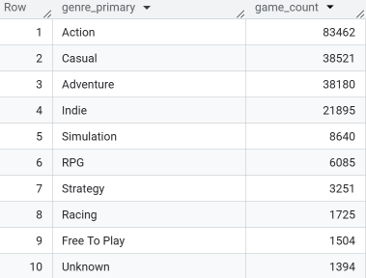
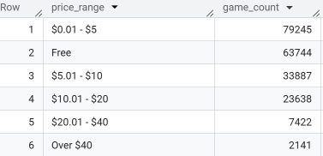

Results
Number of games by genre
Price distribution
Total number of games

Slide 5
Demo Time!

Slide 6
Conclusion
Completed a full analytics pipeline of video game
Used BigQuery for SQL analysis
User will have a better idea of video game market trends by looking at the dashboard
One challenge was cleaning messy data, such as missing values and HTML text fields

Slide 7
Question?

